Slide 1


BOLO 4.0 Team Member(s): Edwin Alvarez Alejandro Henao Leonardo Martin Piero Messarina Product Owner(s): Samuel Ceballos, Jason Cohen Instructor: Masoud Sadjadi School of Computing and Information Sciences Florida International University
Senior Project Final Presentation Spring 2016
May 05
Notes:
Greet your audience, thank them for attending your presentation, introduce yourself, introduce your project, introduce your team members, and quickly indicate what each of you did in a high-level manner, and put more emphasis on your part/contribution.

Slide 2
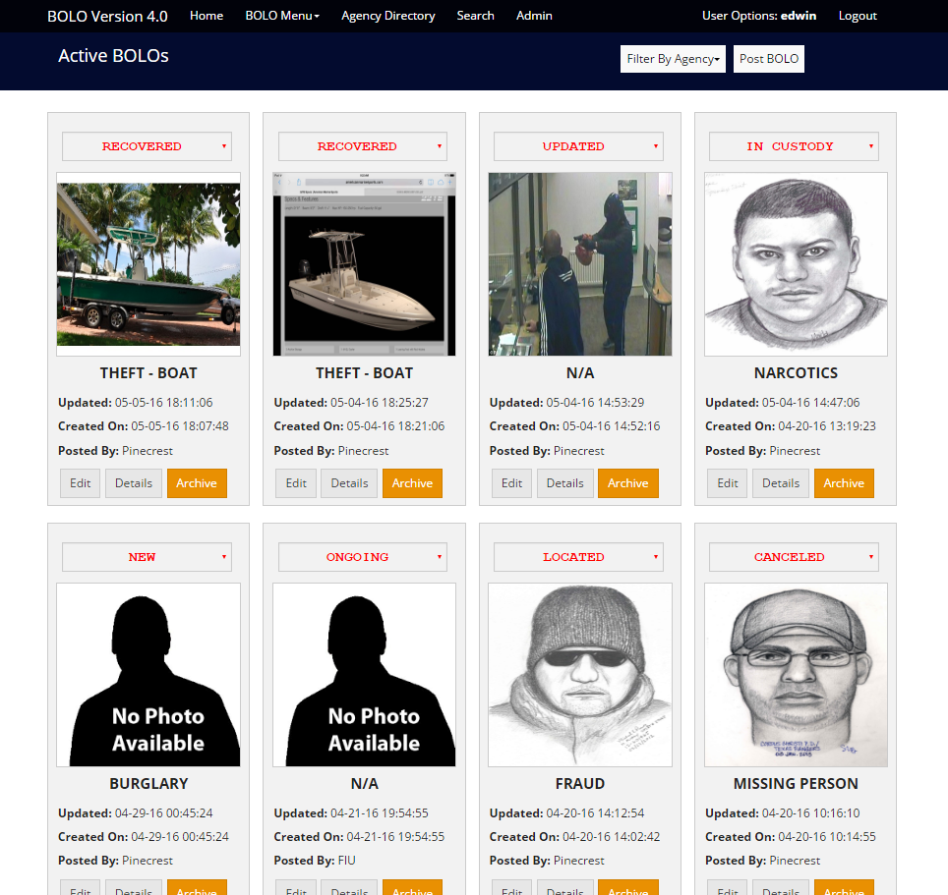
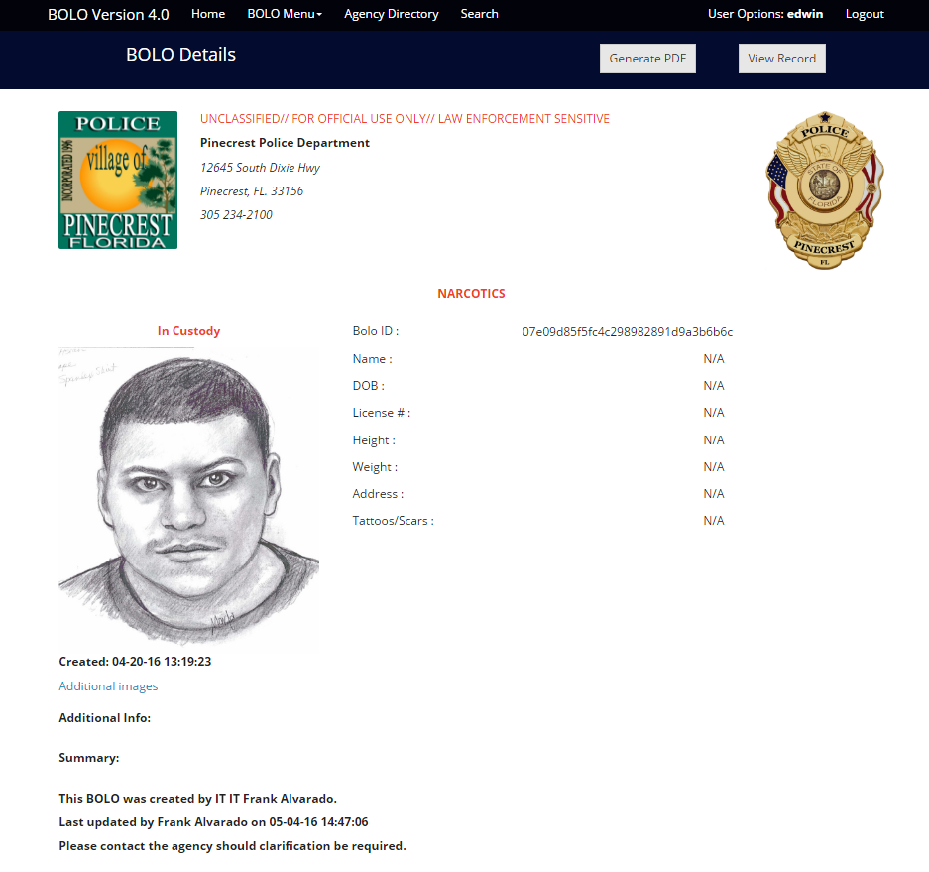

Problem definition
Whole Project:
The BOLO (Be On the Look Out) web-application allows officers to create BOLO's in real time using a personal computer or mobile device and simultaneously disseminate the information to a vast number of police officers with speed.
The earlier version of the web-based BOLO application was moved from FIU servers to the IBM Bluemix Server; critical system functionality was lost in the process. Such functionality includes the ability to attach a PDF version of the issued BOLO within an e-mail alert.
My Part:
Restore key functionality missing in Bolo version 3.0 as well as make performance improvements in the creation of Bolos
Notes:
Introduce the problem that the whole project tackles and stay focused on the parts that you have been working. Indicate if there is an existing previous system, enumerate its problems/limitations, etc.

Slide 3
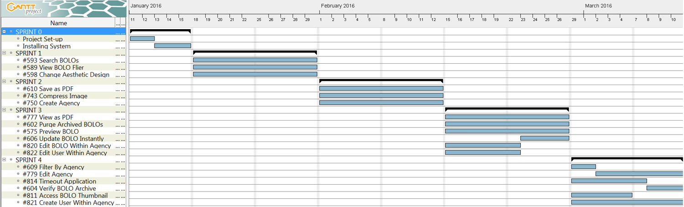
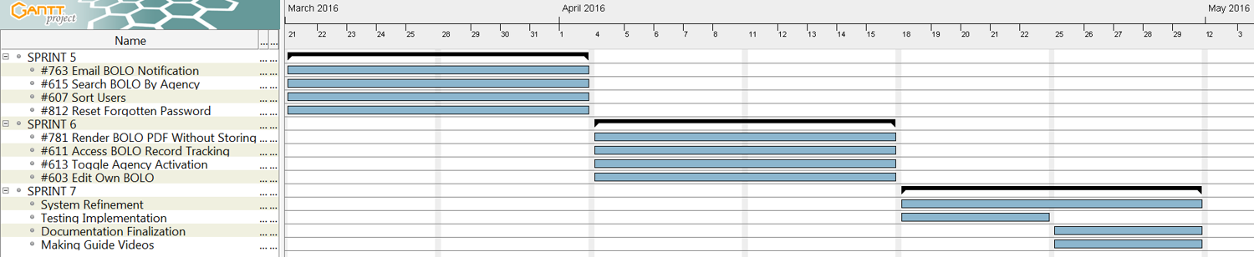
Project Management
Notes:
Project Management (schedule for entire semester) (one slide; Gantt Chart).

Slide 4

Requirements: User Stories
#593 – Bolo Search Feature
#743- Image Compression
#602- Purge Option
#615 –Search Bolo by Agency
#814 –Timeout Application Session
#604- Confirm Archive
#613 – Toggle Agency status
Notes:
4. Requirements:
4.1. User stories implemented (one or more slides).
4.2. UML use cases and the use case diagram for the implemented use cases (one or more slides).
4.3. UML sequence diagrams for the implemented use cases.

Slide 5
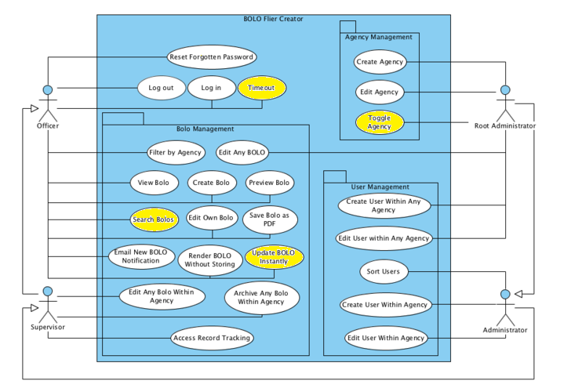
Requirements: Use Cases
Notes:
4. Requirements:
4.1. User stories implemented (one or more slides).
4.2. UML use cases and the use case diagram for the implemented use cases (one or more slides).
4.3. UML sequence diagrams for the implemented use cases.

Slide 6
Use Case ID: BOLO 593(Search BOLOs)
Actor: User.
Preconditions:
The user has previously registered to the system.
The user is logged into the system.
Flow of events:
The user fills out the desired fields in the form rendered on the search page.
The server returns all documents matching specified fields in a response object.
The search/results page is then rendered by the browser as soon as the data is returned.
Decision Support:
Frequency: High. Users may choose to search for specific bolos on a consistent basis.
Criticality: High. It allows the user to view specific information of their choosing that they may deem as important.

Slide 7
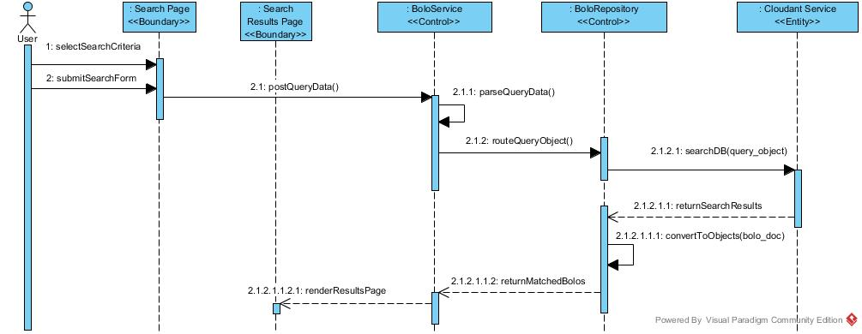
Requirements: Sequence Diagrams
Show the sequence diagram of the most significant use case.
Notes:
4. Requirements:
4.1. User stories implemented (one or more slides).
4.2. UML use cases and the use case diagram for the implemented use cases (one or more slides).
4.3. UML sequence diagrams for the implemented use cases.

Slide 8
System Design: Architecture
Notes:
5. System design:
5.1. System decomposition; identify the architecture patterns used (one slide).
5.2. System deployment – h/w and s/w requirements (one slide).
5.3. Persistent data design (one slide).
5.4. Security/Privacy (one slide).

Slide 9
System Design: Deployment
Notes:
5. System design:
5.1. System decomposition; identify the architecture patterns used (one slide).
5.2. System deployment – h/w and s/w requirements (one slide).
5.3. Persistent data design (one slide).
5.4. Security/Privacy (one slide).

Slide 10

Persistent data design
Cloudant NoSQL DBaaS(Database as a service) provided by IBM Bluemix that offers a RESTful HTTP API
Scalability, Flexible Schema, Fast Development, Cost, Cloud Architecture Compatibility
Documents are stored in the popular JSON format with a flexible schema
Map-Reduce views to obtain data stored within the DB indexed by json type objects
Full text search which utilizes Lucene Query Parser Syntax(full featured text search engine)
Powered by Apache CouchDB, Dynamo Clustering, Lucene Search
Notes:
5. System design:
5.1. System decomposition; identify the architecture patterns used (one slide).
5.2. System deployment – h/w and s/w requirements (one slide).
5.3. Persistent data design (one slide).
5.4. Security/Privacy (one slide).

Slide 11

Security/Privacy
User Password validation through HMAC(Hash-based Message Authentication Code) using a SHA-256 algorithm and a unique password salt.
Cross-Site Request Forgery(CSRF) protection through the use of csrf middleware that embeds unique token into html form for user login page.
Secure cookies preventing client side script access, providing application timeout, and allowing communication only with HTTPS endpoints.
Authenticating HTTP requests through Passport authentication middleware.

Slide 12
Minimal Class Diagram
Notes:
6. Detailed design:
6.1. Minimal class diagram. Identify the design patterns used (one or more slides).
6.2. State machine for the main control object or the most important object of the implemented uses cases (one or more slides).
6.3. Main algorithm used related to an implemented use case described above (one or more slides).

Slide 13
Main algorithm
Sorting search results by date of creation/last update
var flag = true;
while (flag === true) {
flag = false;
for (NUM_OF_BOLOS) {
var order = date_one > date_two ? 1 : date_one < date_two ? -1 : 0;
if (order === -1)
Swap(Bolos)
flag = true;
Notes:
6. Detailed design:
6.1. Minimal class diagram. Identify the design patterns used (one or more slides).
6.2. State machine for the main control object or the most important object of the implemented uses cases (one or more slides).
6.3. Main algorithm used related to an implemented use case described above (one or more slides).

Slide 14
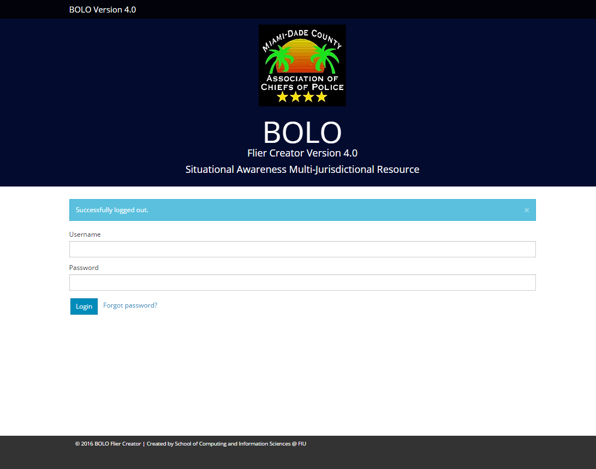
Summary
Summary
Bolo 4.0 has the potential to make a great impact on the efficiency, organization, and responsiveness of police agencies all around the state. Working to restore necessary functionality to this application has been both a challenge as well as a learning experience.
contact information
ealva153@fiu.edu
Questions?
Thank You!
Notes:
Summarize your contribution
Include your contact information
Ask if anyone has any questions for you.
Thank your audience

